Slide 1
Tuesday Talent Series
Tiana Patterson, Esq. VP of Social Impact & Wealth Equity

Slide 2
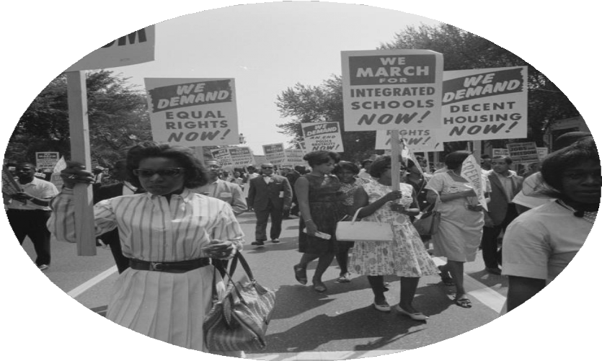
Origins
WHAT IS A CLT?
Rooted in the Civil Rights Movement
Balances the needs of community with the needs of individuals
Creates permanent affordability
Provides a stepping stone into the market
Notes:
The first community land trust, New Communities was created in 1969 to support black farmers. This pioneering initiative was the result of a collaborative effort among farmers and civil rights activists, including members of the Student Nonviolent Coordinating Committee (SNCC).
In exchange for purchasing homes at below-market rates, CLT homeowners agree to resale price restrictions that limit the amount of appreciation they will receive. A portion of that appreciation is reinvested in the home in order to maintain the affordability of the home for the next lower-income buyer.
99 year LL stepping stone

Slide 3
How does a CLT Work?
What is the CLT Model?
Separates the ownership of the land and the improvements
99 year lease partnership
Permanent affordability
Subsidy retention
Balances current and future interests
Notes:
One time investment that gets reinvested

Slide 4
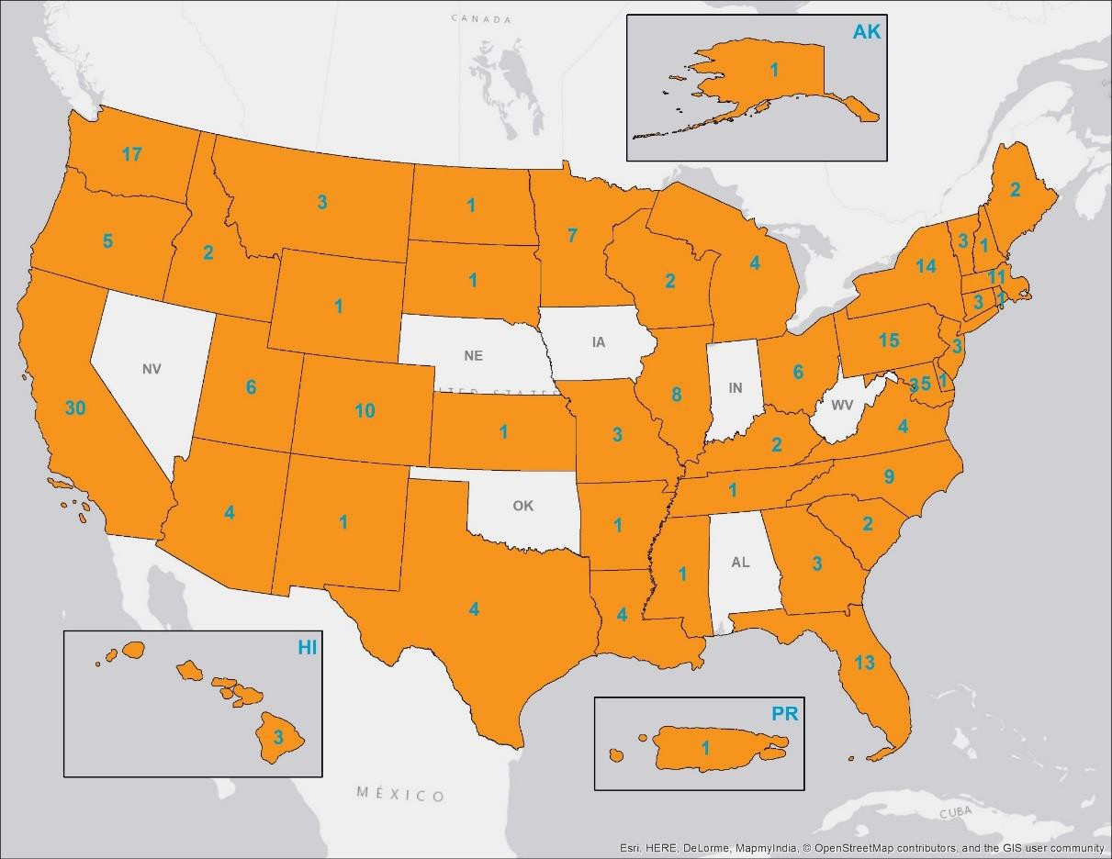
Expansion
CLTs
Today
225+ CLTs nationwide
Exponential growth in the 1990s and… now!
Many working in close collaboration with municipal governments
Partners in implementing inclusionary housing policies, anti- displacement strategies, leveraging existing subsidy, and much more

Slide 5
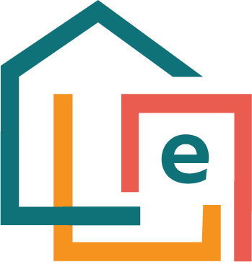
A SHORT HISTORY
2016
2017
2018
2019
2023
RESEARCH AND DEVELOPMENT
$24M INITIAL CAPITAL RAISED
ELEVATION COMMUNITY LAND TRUST LAUNCHED
FIRST HOME
SOLD
500 HOMES IN PORTFOLIO
Notes:
2016 a funder collaborative Gary Community Investments, The Colorado Health Foundation, Gates Family Foundation, The Denver Foundation, Mile High United Way, and Northern Trust, Although the majority of its initial capital was raised from the private sector, Elevation CLT was established as a public-private partnership that requires subsidies from a mix of sources, including the philanthropic community, the public sector, and anticipated land donations from private developers or government entities.
Rather than being concentrated in a single neighborhood, Elevation CLT will use a “scattered site model” that has the flexibility to scale to any community at risk of gentrification and displacement.

Slide 6
OUR FOUNDING
Elevation Community Land Trust was founded in 2017 by a collective of private foundations who recognized the value of permanently affordable homeownership for Colorado.
OUR MISSION
Elevation Community Land Trust partners with Colorado communities to create equitable opportunity for families through permanently affordable homeownership.​
WHAT WE DO​
Elevation makes homeownership more accessible for Colorado families through the community land trust model.​

Slide 7
WHERE WE ARE TODAY
551
Homes
60%
229
Homeowners
BIPOC
Households
76%
$261,000
2023 Median Home Price
Average 2023 AMI

Slide 8
SCATTERED SITES
ECLT has acquired 30 of 44 homes and is in the process of remodeling and selling them to qualified households in Ft. Collins
Ranges from single family homes, historic properties, duplexes, triplex
High opportunity locations, homes in walking distance to Old Town, near Horsetooth Reservoir
Notes:
SS- contract with Denver
Jeff Shanahan—Denver
We only go where we are invited
Work with particular lenders who understand our buyers

Slide 9
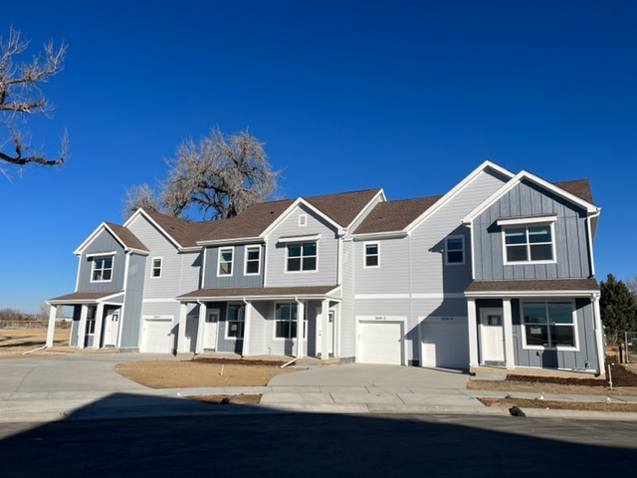
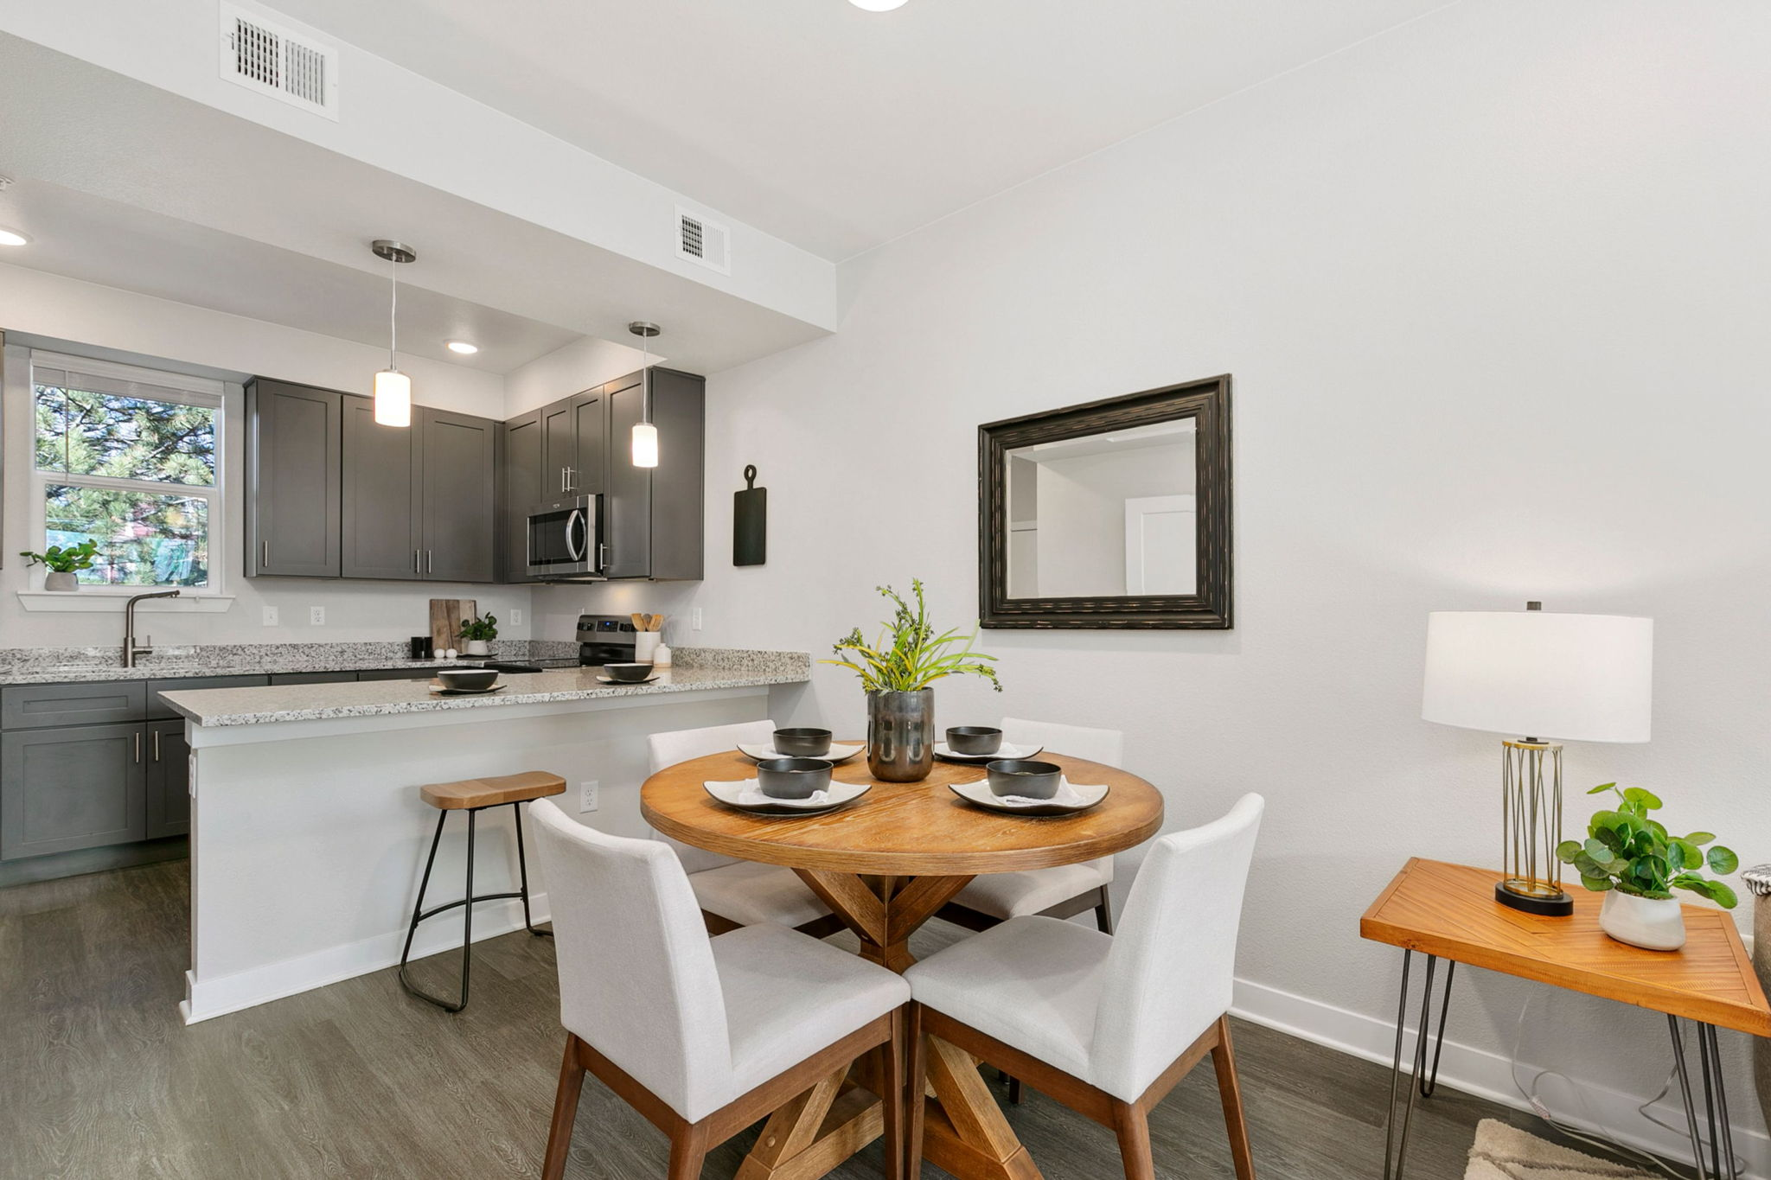
Pricing & Incentives
BirdWhistle
Townhomes
54 Townhomes in Ft. Collins
2bedrooms-$255,000
3bedrooms-$290,000
DPA
$10,000 in AHP (must be a first-time homebuyer)
$25,000 in DPA from IDF (location-specific DPA)
IRBD
2bed-up to $6,375
3bed-up to $7,250

Slide 10
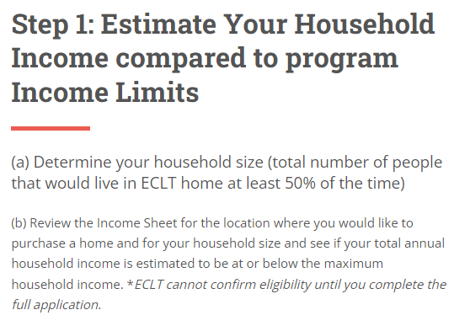
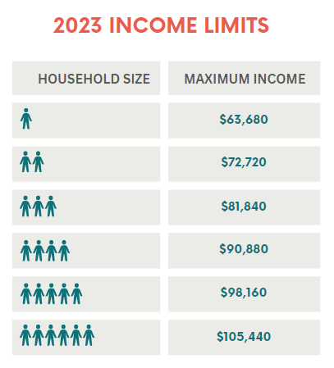
5 Steps to Homeownership
ECLT Application
Process

Slide 11
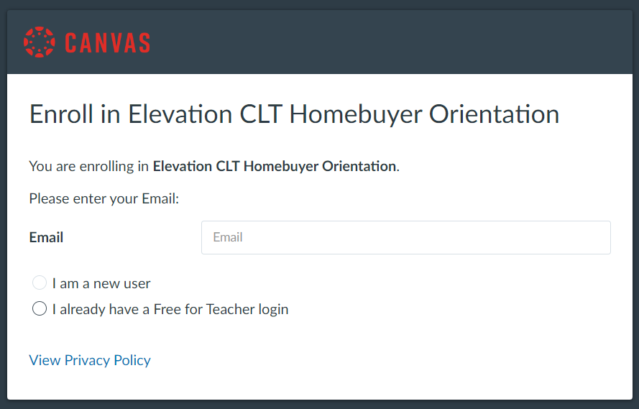
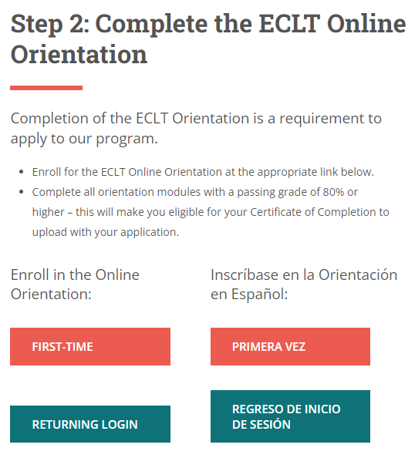
5 Steps to Homeownership
ECLT Application
Process

Slide 12
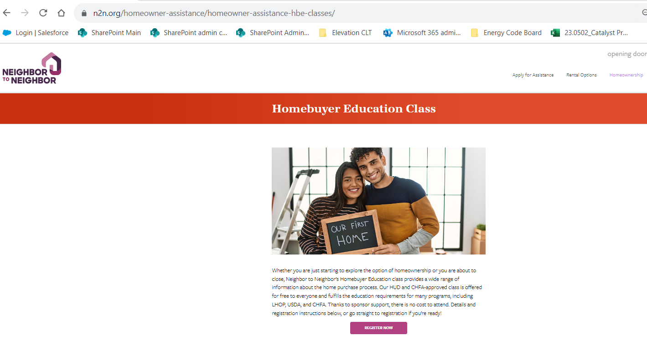
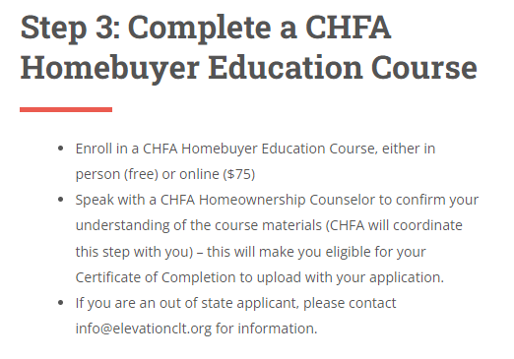
5 Steps to Homeownership
ECLT Application
Process

Slide 13
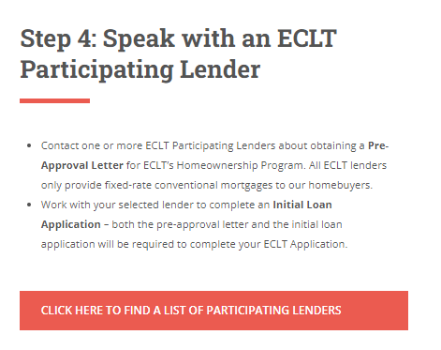
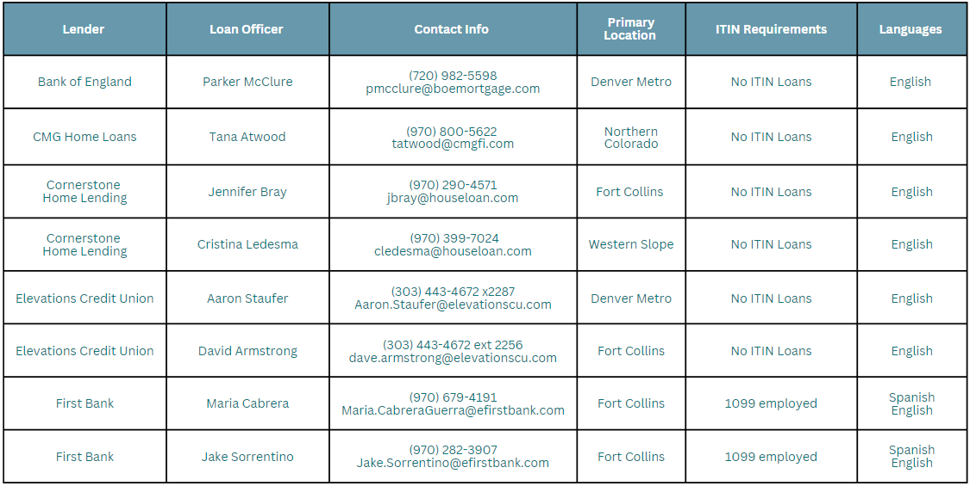
5 Steps to Homeownership
ECLT Application
Process

Slide 14
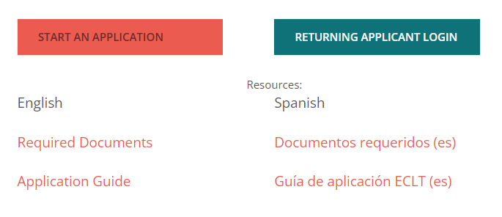
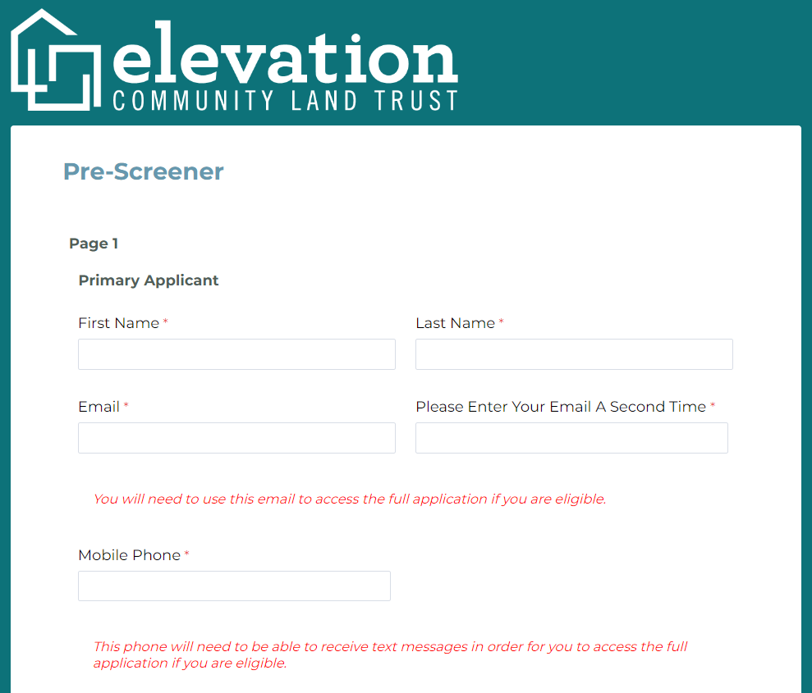
5 Steps to Homeownership
ECLT Application
Process
$25 non-refundable application fee
Application requires both ECLT Orientation completion certificate and CHFA HUD Homebuyer Education completion certificate
Application requires Participating Lender Pre-Approval and Loan Application

Slide 15
Invest in equity. Invest in ownership. Invest in Elevation.
CONTACT US
1114 W 7th Ave, Denver, CO 80204
Info@elevationclt.org
(720) 822-0052
www.elevationclt.org

